Slide 1

Apache Pig

Slide 2
Pig
Introduction to Pig
Execution Modes & Pig Components [Grunt, Pig Latin, Optimizer, Compiler, Parser]
Pig Latin Basics
Case Study
Developers Alert!!!
Resources
Pig vs Hive

Slide 3
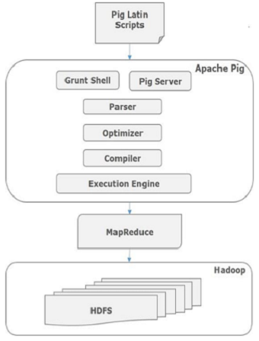
PIG Overview
Pig is a platform for analyzing large data sets
Pig scripts written in Pig Latin – an easy to learn scripting type of language
Pig runs on MR as well as Tez – backend engine also
If Pig using MR, Pig scripts gets converted into optimized MR Jobs

Slide 4
PIG Overview
Definitions
From the creators: Pig is a platform for analyzing large data sets that consists of a high-level language for expressing data analysis programs, coupled with infrastructure for evaluating these programs
What Pig Brings to table
Ease of programming. It is trivial to achieve parallel execution of simple, "embarrassingly parallel" data analysis tasks. Complex tasks comprised of multiple interrelated data transformations are explicitly encoded as data flow sequences, making them easy to write, understand, and maintain
Optimization opportunities. The way in which tasks are encoded permits the system to optimize their execution automatically, allowing the user to focus on semantics rather than efficiency
Extensibility. Users can create their own functions to do special-purpose processing

Slide 5
Pig Overview
So we know,
current implementation compiles Pig Latin programs into Map/Reduce jobs, and executes them using Hadoop on HDFS file system
Pig works can work well with semi structured data also. e.g.,: log files
Pig is a high-level language for writing analytical expressions over such sort of data
A query planner compiles queries written in this language (called "Pig Latin") into maps and reduces which are then executed on a Hadoop cluster
Every task which can be achieved using PIG can also be achieved using java implementing in Map reduce

Slide 6
The Pig Power
What Pig Does Best
Join Datasets
Sort Datasets
Filter
Data Types
Group By
User Defined Functions
In Industry its used for
Mostly processing large amount of raw data Logs , Extract Transform logs (ETL)
Data Exploration

Slide 7
Pig Components
Pig Latin
Command based language
Designed specifically for data transformation and flow expression
Execution Environment
The environment in which Pig Latin commands are executed
Currently there is support for Local and Hadoop modes
Pig compiler converts Pig Latin to MapReduce
Compiler strives to optimize execution
You automatically get optimization improvements with Pig updates

Slide 8
Pig Execution modes
Local
Executes in a single JVM
Works exclusively with local file system
Great for development, experimentation and prototyping
Command to Start Pig in Local mode
pig –x local
Hadoop Mode
Also known as MapReduce mode. [ This is default mode ]
Pig renders Pig Latin into MapReduce jobs and executes them on the cluster
Can execute against semi-distributed or fully-distributed hadoop installation
Command to Start Pig in Hadoop mode
Simply do not specify any mode, It will start as default mode
pig

Slide 9
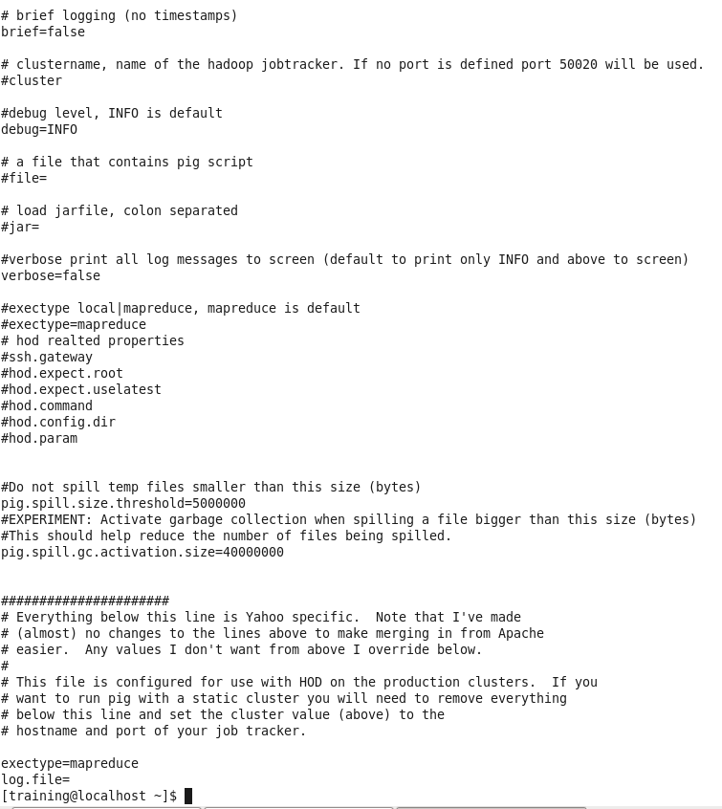
Pig Configuration
cat /etc/pig/conf/pig.properties
Pig.properties file has most of pig configurations which can be changed by root/ admin user of the cluster.
For example : See exectype = mapreduce. This sets Pig execution engine to Map Reduce. Alternatively You can use any other processing engine for pig like Tez.

Slide 10
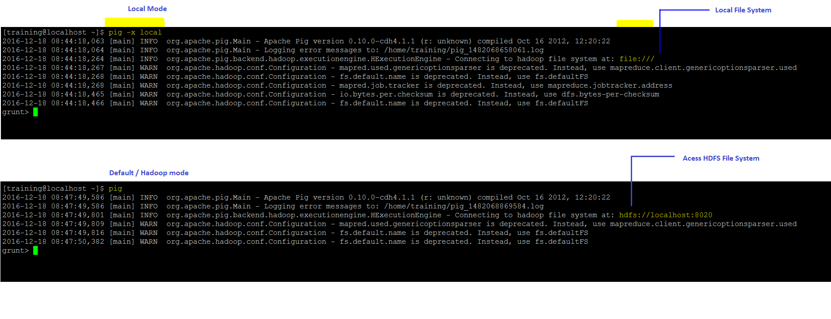
Pig Execution Mode

Slide 11
Pig
Pig Latin
The programming language used to write Pig queries is called Pig Latin
Introduction to
Grunt

Slide 12
Pig Latin Building Blocks
Building blocks
Field - piece of data
Tuple - ordered set of fields, represented with ( )
Bag - Collection of tuples, represented with “{“ and”}”
Map - Key Value pair represented as key# value
Example
In RDBMS, An employee table contains records. Each record represents an employee. Each employee record describes an employee by employee id, name and age – which are fields
Similarly,
(100, “Joe Smith”, 30) is a Tuple with three fields employee Id, Name and Age.
Employee Table is a Bag as below which has two tuples
{(100, “joe Smith”, 30),(101, “Lee Chong”, “29”)}

Slide 13
Pig Latin Building Blocks [Cont.]
With reference to Relational Database
Bag is a table in the database
Tuple is a row in a table
Unlike relational table Bags do not require that all tuples contain the same number of fields *this means, {(100, “joe Smith”, 30),(101, “Lee Chong”)} – Tuples with heterogeneous number of fields is valid and that’s what make Pig easy to work with semi-structured data.

Slide 14
Generate Complex Data Types
Prepare Input File and put it on HDFS
Tab separated Input File (students.tsv):
joe smith 20 3.5
amy chen 22 3.2
leo allen 18 2.1
1 Tuple Construction
A = load ‘your hdfs path to/students.tsv' as (name:chararray, age:int, gpa:float);
B = foreach A generate (name, age);
DUMP B;
Output (results):
(joe smith,20)
(amy chen,22)
(leo allen,18)

Slide 15
2 Bag Construction
A = load ‘path to hdfs/students.tsv' as (name:chararray, age:int, gpa:float);
B = foreach A generate {(name, age)}, {name, age};
DUMP B;
Output : (generates two bags with same fields)
{(joe smith,20)} {(joe smith),(20)}
{(amy chen,22)} {(amy chen),(22)}
{(leo allen,18)} {(leo allen),(18)}

Slide 16
3 Map Construction
A = load ‘path to hdfs/students.tsv' as (name:chararray, age:int, gpa:float);
B = foreach A generate [name, gpa];
DUMP B;
Output:
[joe smith#3.5]
[amy chen#3.2]
[leo allen#2.1]

Slide 17
Pig Functions
Load/Store Functions
Load Data Sets
Store Data Sets to HDFS
Filter Function
Filter records based on condition
Eval Functions
Evaluate values like, Sum, Average, Max, Count etc
Group By
Group by
Flattern
UDFs – User Defined Functions
Custom functions can be defined of either of three types – Load/Store, Eval or Filter

Slide 18
PIG Latin data types
Simple Data Types | Description | Example
Scalars
int | Signed 32-bit integer | 10
long | Signed 64-bit integer | Data: 10L or 10l Display: 10L
float | 32-bit floating point | Data: 10.5F or 10.5f or 10.5e2f or 10.5E2F Display: 10.5F or 1050.0F
double | 64-bit floating point | Data: 10.5 or 10.5e2 or 10.5E2 Display: 10.5 or 1050.0
Arrays
chararray | Character array (string) in Unicode UTF-8 format | hello world
bytearray | Byte array (blob)
Complex Data Types
tuple | An ordered set of fields. | (19,2)
bag | An collection of tuples. | {(19,2), (18,1)}
map | A set of key value pairs. | [open#apache]

Slide 19
Lets Learn by Solving a Case Study

Slide 20
Case Study
Problem Statement :
ABC Entertainments is a production house and required to finalize roadmap for coming year.
As an entertainment business with major focus on movies production, business needs to make multiple decisions.
For example,
For social media marketing what age group, gender or profession people should be targeted ?
For a given set of viewers what type of movie is most appreciated, to be able to decide before investing.
Solution:
As we are given with historic data set for movies, its ratings and user’s details we can analyze some information from it. For the scope of case study we will consider data set from movieLense labs for all the movies released in April 1998 – approx. 1700 movies with 100 Thousand ratings.

Slide 21
Case Study [Contd.]
Should we choose Hive or Pig for this case ?
Data sets are provided as flat files.
It requires to perform some joins, aggregations and filter on data sets to achieve end results.
Since we are not fully aware of dataset and data quality, we may be interested to explore data initially to learn about data set !
We might be interested to store intermediate results of our analysis
This problem cane be solved with Hive, Pig or Map Reduce programs also.
As we are interested to store multiple intermediate results – Pig fits well here. With Hive we have to create those many intermediate tables and take care of truncating during each run.
Since there are join, filter and aggregation operation similar can be achieved with Hive. When you will compare Hive solution script with Pig, Pig script is going to look short and simple. It makes it easy scripting for complex analytical jobs.
Since we don’t know actual data quality before starting, initial data exploration can be done with Pig, without worrying about data formats and fields within, Since we don’t need to create any sort of tables here !

Slide 22
Case Study
Data Set Used for Case Study : Movie Review Data Set from MovieLens Labs.
Stable benchmark dataset. 100,000 ratings from 1000 users on 1700 movies. Released 4/1998.
GroupLens Research has collected and made available rating data sets from the MovieLens web site (http://movielens.org). The data sets were collected over various periods of time, depending on the size of the set. Before using these data sets, please review their README files for the usage licenses and other details.
Attached : movie-100k.zip

Slide 23
Case Study [Cont.]
Data Directory : movie-100k
There are multiple “|” separated files in this directory, few are described below which will be used in this session.
File Name | Description | Fields in File | Fields separator
u.data | Ratings data | user id, item id, rating, timestamp | Tab
u.Item | Movie data | movie id, movie title, release date, video release date,IMDb URL, unknown, Action, Adventure, Animation, Children's, Comedy, Crime, Documentary, Drama, Fantasy, Film-Noir,Horror, Musical, Mystery, Romance, Sci-Fi, Thriller, War, Western | |
u.User | User demographic data | user id, age, gender, occupation, zip code | |

Slide 24
Pig Latin Syntax – Before we start using them
Load/Store Function
dataSetX = LOAD ‘{HDFS Path}’ USING {Load Function Name} AS [{schema Specification - optional}]
Filter Function
filteredData = FILTER {dataset} BY {Condition}
Group
groupedDataSet = GROUP {dataset} BY {some field of dataset}
This returns a Bag, which has first field as Group Key and second fields will be a Bag with all tuples grouped by specified Key.
Loop – Foreach & Generate
Foreach is an iterator and generate allows to generate new Tuple/Bag/Map with specified fields
resultDataSet = FOREACH {bag dataset} GENERATE {field1, filed2 ….}
[see slide 14]
Join
joinResult = JOIN {dataSet1} BY {commonFieldFromDataSet1}, {dataSet2} BY {commonFieldFromDataSet2}

Slide 25
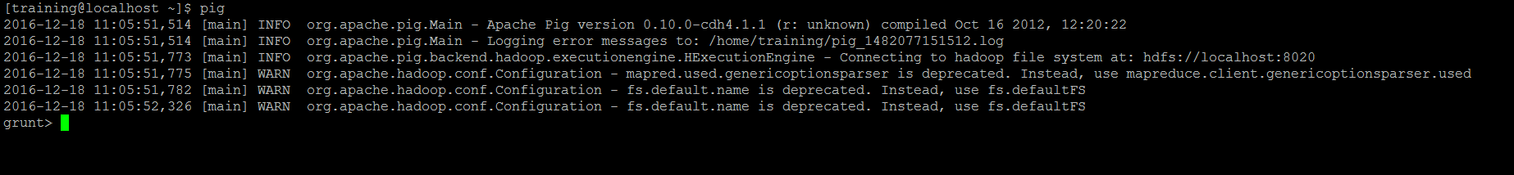
Case Study [Cont.]
Load data in HDFS
First load movie-100k folder to HDFS from your local file system
We will run Pig in default i.e Hadoop mode and Pig will look for Data on HDFS in that case.
hadoop fs –put /local path to data set/movie-100k /desired-hdfs-path/
Start Pig in default mode with below command
Pig
This will start pig console called grunt

Slide 26
Case Study [Cont.]
Find Simple Statistic from given Data Set
Statistic about User’s age
User data is available in u.user file. First thing required is to load this data set
users = LOAD '/hdfs-path-to/movie-100k/u.user' USING PigStorage('|') AS (userId,age,gender,occupation,zipCode);
Verify if above step is valid by simply dumping data from data set loaded above
Try: dump users;
Expected output is data from file should be seen on console
Note: All Keywords like LOAD, FILTER are marked in capital letters just to highlight. They are case-insensitive.

Slide 27
Case Study [Cont.]
Statistic about User’s age [Cont.]
allUsers = GROUP users ALL;
stats = FOREACH allUsers GENERATE COUNT(users), AVG(users.age), SUM(users.age);
dump stats;
Expect Total Count of Users, average age of all users and Total Sum of all user’s age !
Gender distribution
byGender = GROUP users BY gender;
genderStats = FOREACH byGender GENERATE group, COUNT(users), AVG(users.age);
dump genderStats;
Expect gender wise count and average age of user in each gender !

Slide 28
Case Study [Cont.]
Filter user by profession and find age group wise count of users in particular profession
Lets filter programmers !
programmers = FILTER users BY occupation == 'programmer';
progsByAge = GROUP programmers BY age;
progCountsByAge = FOREACH progsByAge GENERATE group AS age, COUNT(programmers) as NumProgs;
progsCountsByAgeSorted = ORDER progCountsByAge BY NumProgs DESC;
Try
dump progsCountsByAgeSorted;
Dump is good to show results on screen. How do I persist result on Disk ?
Use Store Function to Store dataset into HDFS file!

Slide 29
Case Study [Cont.]
Store Data sets in HDFS Files
STORE stats INTO ‘hdfs-path-to-non-existing-dir’ USINg PigStorage('\t');
STORE genderStats INTO ‘hdfs-path-to-non-existing-dir’ USING
PigStorage('\t');
STORE progsCountsByAgeSorted INTO ‘hdfs-path-to-non-existing-dir’ USING PigStorage('\t');

Slide 30
Case Study [Cont.]
3 Find Top 25 Rated Movies
Load Votes data set
votes = LOAD '/user/training/movie-100k/u.data' USING PigStorage('\t') AS (userId,itemId,rating,timestamp);
Load movies data set
movies = LOAD '/user/training/movie-100k/u.item' USING PigStorage('|') AS (movieId,movieTitle, releaseDate, videoReleaseDate, imdbURL, unknown, Action, Adventure, Animation, Childrens, Comedy, Crime, Documentary, Drama, Fantasy, FilmNoir, Horror, Musical, Mystery, Romance, SciFi,Thriller,War,Western);

Slide 31
Case Study [Cont.]
Group votes by Item id /movie id
movieVotesGroup = GROUP votes BY itemId;
Flattern above generated relation and generate average rating, count of votes for a movie id
movieVotes = FOREACH movieVotesGroup GENERATE FLATTEN(group) AS movieId,
AVG(votes.rating) AS avgRating, COUNT(votes) AS numVotes;
Join movieVotesGroup and movieVotes data sets
moviesWithVotes = JOIN movieVotes BY movieId, movies BY movieId;
Sort
moviesWithVotesSorted = ORDER moviesWithVotes BY movieVotes::avgRating DESC;
Get Top 25
top25 = LIMIT moviesWithVotesSorted 25;
Store Result
STORE top25 INTO ‘some-hdfs-dir’ USING PigStorage('\t');

Slide 32
Case Study [Cont.]
Some Practice Assignments on same data set
How many are between 35 and 59
How many of these are females
Find eldest user who is not programmer or doctor

Slide 33
User Defined Functions (UDFs)
Pig provides extensive support for user defined functions (UDFs) as a way to specify custom processing.
Pig UDFs can currently be implemented in three languages: Java, Python, and JavaScript.
Pig also provides support for Piggy Bank, a repository for JAVA UDFs.
Type of UDFs
Eval Functions
Filter Functions
Load Functions
Store Functions

Slide 34
User Defined Functions (UDFs) [Contd.]
All user defined Evaluation functions extend “org.apache.pig.EvalFunc”
All functions must override “exec” method.
3) “pig-0.10.0-cdh4.1.1-withouthadoop” make sure this file is in your build path apart from all other files that were mentioned in previous class .
This file is present in “usr/lib/pig/”
Other files are in “usr/lib/hadoop/client-0.20”

Slide 35
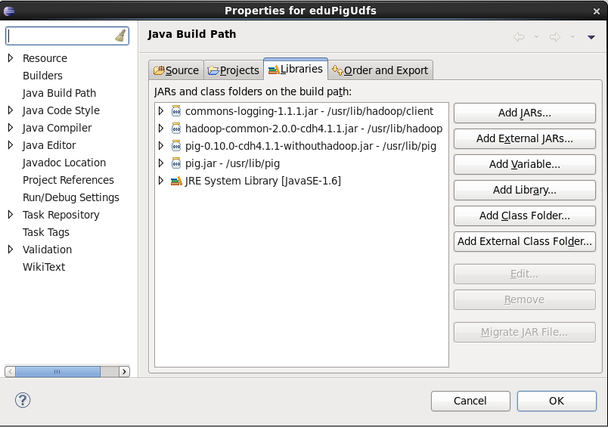
Filter Function For our User Data Set
Lets says, we would like to filter user who are in their 30s and in any technical profession.
Although, It’s a simple example, Idea is to understand Custom Filter Function.
We will write Custom Filter Function ‘FilterTechProfessionalsInAgeOf30s’ in Java.
Libraries added for UDF

Slide 36
Java Eclipse Project for UDF
Source Code and Pig Script using UDF
Export Project as JAR file and Refer below Pig Script to Use UDF
Name of Class becomes Name of Function prefixed with Package name if any.
In Grunt >
users = LOAD ‘your u.user file path on HDFS’ USING PigStorage('|') AS (userId, age, gender, occupation: chararray, zipCode);
REGISTER /Your Local Path to/ExportedUdf.jar;
filtered = FILTER users BY com.edupristine.training.pig.FilterTechProfessionalsInAgeOf30s();
dump filtered;

Slide 37
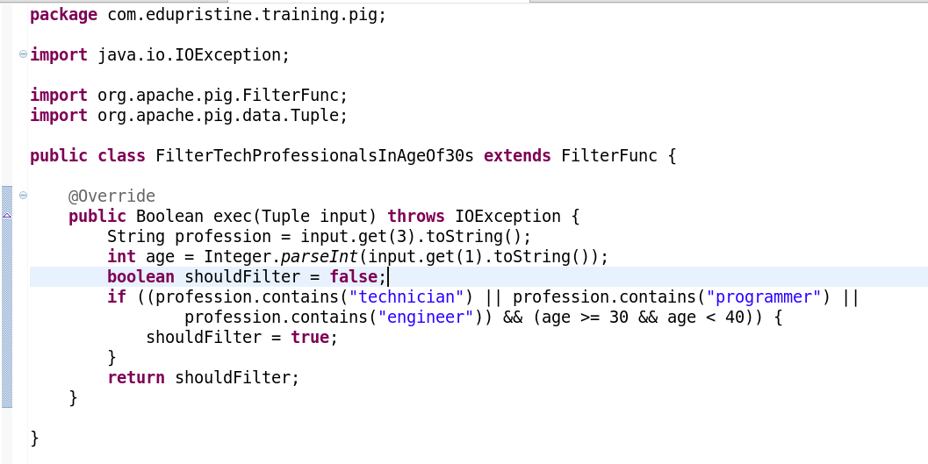
Java UDF Code for Custom Filter Condition implementation

Slide 38
Running Pig Script
In real scenario, You are likely to develop your solution by trying out each steps and write next statement. Once you have solution script tested and ready, You would like to schedule it or run it as a batch job. Just put all your pig statements in one “.pig” file and run as a script.
For example : in your command prompt
$> pig pig_UserUdf.pig

Slide 39
Pig Developer’s tool
IILLUSTRATE - Use the ILLUSTRATE operator to review how data is transformed through a sequence of Pig Latin statements. know more
DESCRIBE - to review the schema of a particular alias. know more
EXPLAIN - Displays execution plans. know more

Slide 40
PIG Resources …
Apache
https://pig.apache.org/
Yahoo Developer Network
http://developer.yahoo.com/hadoop/tutorial/pigtutorial.html
Horton Works
http://hortonworks.com/hadoop/pig/

